Slide 1



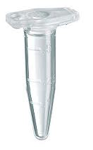
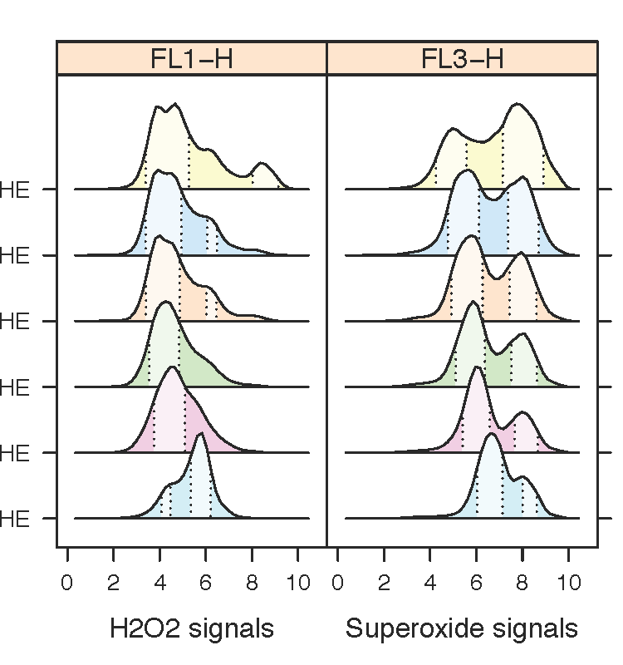
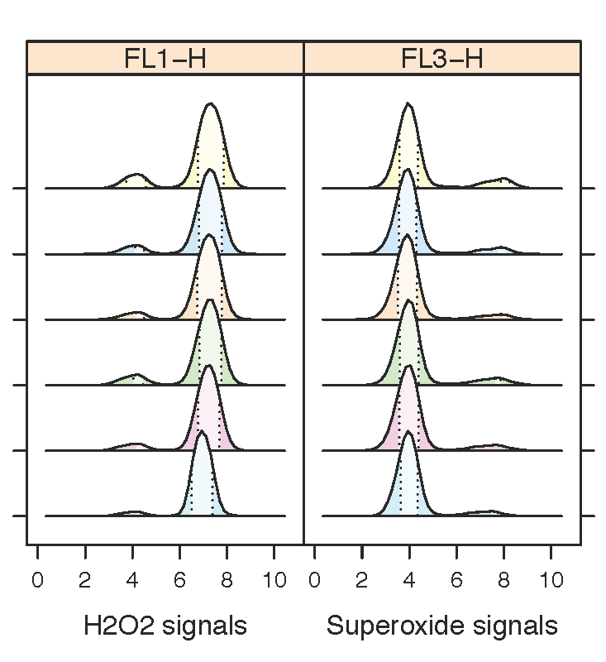
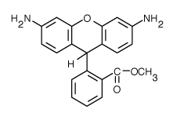
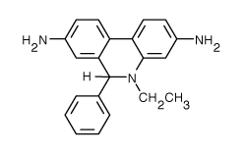
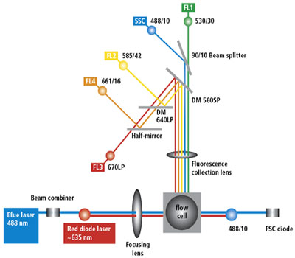
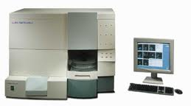



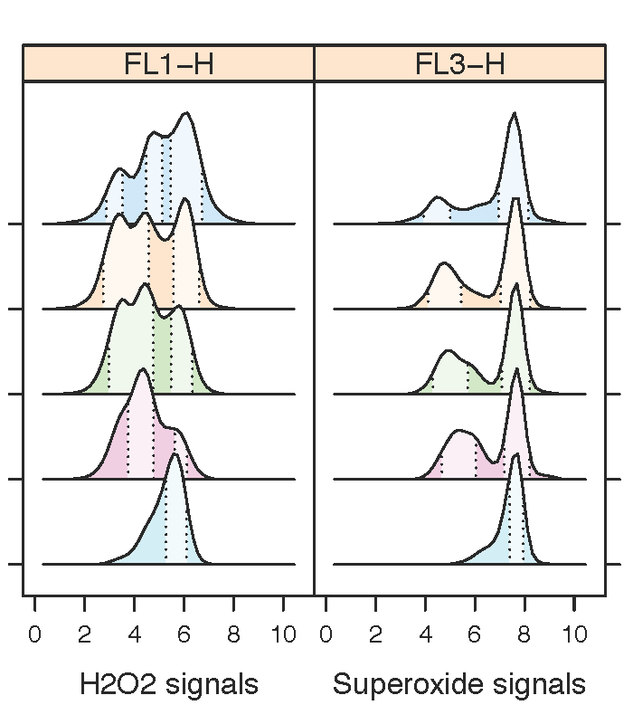
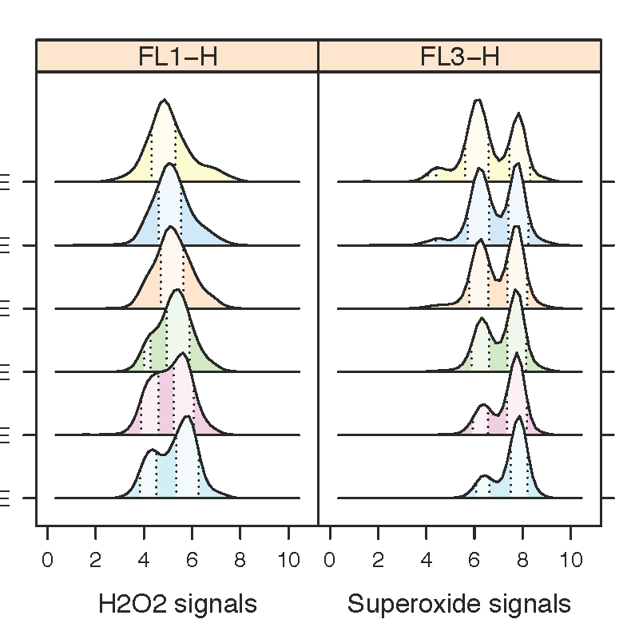
Hydrogen Peroxide Treatment Increases Heterogeneity of Intracellular Reactive Oxygen Species Levels and Decreases Cellular Robustness in Saccharomyces cerevisiae.
Ashlee Beverett; Jayden Le Blanc; Nilin Gupta; Hong Qin
Department of Biology, Spelman College, Atlanta, GA 30314
Abstract
Cellular aging, the basis of physiological aging, can be studied in the model organism of Saccharomycescerevisiae. Previous studies in our group show a significant connection amongst cellular aging, intracellular hydrogen peroxide, and genomic instability. In this study, we investigate how extracellular hydrogen peroxide influence the balance of intracellular hydrogen peroxide and superoxide in a collection of natural isolates. Intracellular hydrogen peroxide is detected by dihydrorhodamine 123 (DHR) and superoxide is detected by dihydroethidium (DHE). We used 0 to 0.1% extracellular hydrogen peroxide to induce oxidative stress for cells. Fluorescent signals of stained cells were monitored using flow cytometry. We found that hydrogen peroxide treatment can induce more heterogeneity in most natural isolates - increasing the number of subpopulations of cells. This increased heterogeneity is reflected in increased coefficient of variation (CV) in DHR and/or DHE fluorescent signals, suggesting that higher hydrogen peroxide tends to decrease cellular robustness. Moreover, we found that cells under calorie restriction (CR) are more resistant to hydrogen peroxide treatment; in the sense that the increase of CV in fluorescence signals are much weaker than cell in normal growth conditions, indicating that CR increases cellular robustness. Overall, our study revealed an intricate picture of reactive oxygen species regulation in cells.
Experimental Design
Ectopic hydrogen peroxide treatment
Results
H₂O₂
SOD2 is not required for H2O2 effect.
0%
0.01%
0.025%
0.05%
0.1%
Strain BY4743
Strain sod2Δ/Δ
0.15%
H₂O₂
0.2%
0.1%
0.075%
0.05%
0.025%
0%
H₂O₂
0.2%
0.1%
0.075%
0.05%
0.025%
0%
Dihydrorhodamine 123
(DHR)
Dihydroethidium
(DHE)
Summary
Introduction
Materials and Methods
H2O2
Reactive oxygen species (ROS) cause cellular and physiology aging.
Different yeast strain types were grown, the cells were restaged, a hydrogen peroxide treatment was performed, a DHR and DHE labeling was performed, then DHR and DHE were both labeled in calibur. FACS data were analyzed using R package flowCore and flowClust available at bioconductor.org.
Superoxide dismutase (SOD)
H₂O₂
Mitochondria, peroxisomes, other cellular metabolic processes
Superoxide
Hydroxy radical
Macromolecule Damage (DNA, Protein, RNA)
Cellular aging
Heart Disease
AGING
Cancer
Increase in probability of developing age-related diseases
Alzheimer’s Disease
Conclusions
In conclusion, from investigating how extracellular hydrogen peroxide influences the balance of intracellular hydrogen peroxide and superoxide in a collection of natural isolates, we found out that hydrogen peroxide treatment can induce more heterogeneity in most natural isolates.
Results
H2O2 increases CV and decreases robustness
Concept of Robustness
Strain YPS163
Strain M5
Robustness = Ability of cells to maintain homeostasis in the presence of genetic, environmental, and stochastic variations.
Robustness can be measured by coefficient of variation (CV).
H₂O₂
0.2%
0.1%
0.075%
0.05%
0.025%
0%
H₂O₂
0.2%
0.1%
0.075%
0.05%
0.025%
0%
CV = Standard deviation / Mean
References
1. Martin Weinberger. “Growth signaling promotes Chronological aging in budding yeast by inducing superoxide anions that inhibit quienscence.” AGING 2 (2010): 709-726
2. Qin H, Lu M, Goldfarb DS, 2008 Genomic Instability Is Associated with Natural Life Span Variation in Saccharomycescerevisiae. PLoS ONE 3(7):
Smaller CV
Larger CV
Acknowledgement
Funding: We would like to give our thanks and appreciation for a seed grant from the Spelman CHDRE Award from the NCMHD (Grant number 5P20MD000315-05), NSF RUI 1022294.
Less noise
More robust
More noise
Less robust
Hypothesis
Oxidative stress contributes to cellular aging by decreasing cellular robustness .

